Slide 1
Introduction to HTML

Slide 2
Definitions
W W W – World Wide Web.
HTML – HyperText Markup Language – The Language of Web Pages on the World Wide Web.
HTML is a text formatting language.
URL – Uniform Resource Locator.
Browser – A software program which is used to show web pages.

Slide 3
“Normal text” surrounded by bracketed tags that tell browsers how to display web pages
Pages end with “.htm” or “.html”
HTML Editor – A word processor that has been specialized to make the writing of HTML documents more effortless.
Notes:
09/22/97
3
University of Minnesota Extension Service
Master Internet Volunteer Program
Provide information in an organized way
Chat Groups
Specialized information areas
Internet access

Slide 4
Tags
Codes enclosed in brackets
Usually paired
<TITLE>My Web Page</TITLE>
Not case sensitive
<TITLE> = <title> = <TITLE>

Slide 5
Creating a Basic Starting Document
<HTML>
<HEAD>
<TITLE>SRM University</TITLE>
</HEAD>
<BODY>
This is what is displayed.
</BODY>
</HTML>
Notes:
09/22/97
9
University of Minnesota Extension Service
Master Internet Volunteer Program
Tech help should be a local or toll-free call
Is it available when you are using the net?
Will you get a real person or have to leave voice mail? (voice mail is OK if the response time is fast and during a time you are not connected)
Try calling tech support before subscribing.

Slide 6
Color Codes
WHITE
BLACK
RED
GREEN
BLUE
MAGENTA
CYAN
YELLOW
AQUAMARINE
BAKER’S CHOCOLATE
VIOLET
BRASS
COPPER
PINK
ORANGE
#FFFFFF
#000000
#FF0000
#00FF00
#0000FF
#FF00FF
#00FFFF
#FFFF00
#70DB93
#5C3317
#9F5F9F
#B5A642
#B87333
#FF6EC7
#FF7F00

Slide 7
Background Color
To set your document’s background color,. The following example will display a document with a white background color:
<BODY BGCOLOR=“#FFFFFF”></BODY>

Slide 8
TEXT Color
The TEXT attribute is used to control the color of all the normal text in the document.
<BODY BGCOLOR=“#FFFFFF” TEXT=“#FF0000”></BODY>

Slide 9
Using Image Background
The BODY element also gives you ability of setting an image as the document’s background.
<BODY BACKGROUND=“hi.gif” BGCOLOR=“#FFFFFF”></BODY>

Slide 10
Headings, <Hx> </Hx>
<HTML>
<HEAD>
<TITLE> Example Page</TITLE>
</HEAD>
<BODY>
<H1> Heading 1 </H1>
<H2> Heading 2 </H2>
<H3> Heading 3 </H3>
<H4> Heading 4 </H4>
<H5> Heading 5 </H5>
<H6> Heading 6 </H6>
</BODY>
</HTML>
Heading 1
Heading 2
Heading 3
Heading 4
Heading 5
Heading 6

Slide 11
Paragraphs, <P> </P>
<HTML><HEAD>
<TITLE> Example Page</TITLE>
</HEAD>
<BODY></H1> Heading 1 </H1>
<P> Paragraph 1, ….</P>
<H2> Heading 2 </H2>
<P> Paragraph 2, ….</P>
<H3> Heading 3 </H3>
<P> Paragraph 3, ….</P>
<H4> Heading 4 </H4>
<P> Paragraph 4, ….</P>
<H5> Heading 5 </H5>
<P> Paragraph 5, ….</P>
<H6> Heading 6</H6>
<P> Paragraph 6, ….</P>
</BODY></HTML>
Heading 1
Paragraph 1,….
Heading 2
Paragraph 2,….
Heading 3
Paragraph 3,….
Heading 4
Paragraph 4,….
Heading 5
Paragraph 5,….
Heading 6
Paragraph 6,….

Slide 12
Break, <BR>
<HTML>
<HEAD>
<TITLE> Example Page</TITLE>
</HEAD>
<BODY>
<H1> Heading 1 </H1>
<P>Paragraph 1, <BR>
Line 2 <BR> Line 3 <BR>….
</P>
</BODY>
</HTML>
Heading 1
Paragraph 1,….
Line 2
Line 3
….

Slide 13
Horizontal Rule, <HR>
The <HR> element causes the browser to display a horizontal line (rule) in your document.
<HR> does not use a closing tag, </HR>.

Slide 14
Horizontal Rule, <HR>
Attribute | Description | Default Value
SIZE | Height of the rule in pixels | 2 pixels
WIDTH | Width of the rule in pixels or percentage of screen width | 100%
NOSHADE | Draw the rule with a flat look instead of a 3D look | Not set (3D look)
ALIGN | Aligns the line (Left, Center, Right) | Center
COLOR | Sets a color for the rule (IE 3.0 or later) | Not set

Slide 15
Horizontal Rule, <HR>
<HTML>
<HEAD>
<TITLE> Example Page</TITLE>
</HEAD>
<BODY>
<H1> Heading 1 </H1>
<P>Paragraph 1, <BR>
Line 2 <BR>
<HR>Line 3 <BR>
</P>
</BODY>
</HTML>
Heading 1
Paragraph 1,….
Line 2
___________________________
Line 3

Slide 16
Bold, Italic and other Character Formatting Elements
<FONT SIZE=“+2”> Two sizes bigger</FONT>
The size attribute can be set as an absolute value from 1 to 7 or as a relative value using the “+” or “-” sign. Normal text size is 3 (from -2 to +4).
<B> Bold </B>
<I> Italic </I>
<U> Underline </U>
Color = “#RRGGBB” The COLOR attribute of the FONT element. E.g., <FONT COLOR=“#RRGGBB”>this text has color</FONT>
<PRE> Preformatted </PRE> Text enclosed by PRE tags is displayed in a mono-spaced font.

Slide 17
Bold, Italic and other Character Formatting Elements
<EM> Emphasis </EM> Browsers usually display this as italics.
<STRONG> STRONG </STRONG> Browsers display this as bold.
<TT> TELETYPE </TT> Text is displayed in a mono-spaced font. A typewriter text, e.g. fixed-width font.
<CITE> Citation </CITE> represents a document citation (italics). For titles of books, films, etc. Typically displayed in italics. (A Beginner's Guide to HTML)

Slide 18
Bold, Italic and other Character Formatting Elements
<P> <FONT SIZE=“+1”> One Size Larger </FONT> - Normal –
<FONT SIZE=“-1”> One Size Smaller </FONT> <BR>
<B> Bold</B> - <I> italics</I> - <U> Underlined </U> -
<FONT COLOR=“#FF0000”> Colored </FONT> <BR>
<EM> Emphasized</EM> - <STRONG> Strong </STRONG> - <TT> Tele Type </TT> <BR>
One Size Larger - Normal – One Size Smaller Bold - italics - Underlined - Colored Emphasized - Strong - Tele Type

Slide 19
Alignment
<DIV ALIGN=“value”></DIV> Represents a division in the document and can contain most other element type. The alignment attribute of the DIV element is well supported.
<TABLE></TABLE> Inside a TABLE, alignment can be set for each individual cell.

Slide 20
Special Characters & Symbols
Special Character | Entity Name | Special Character | Entity Name
Ampersand | &amp; & | Greater-than sign | &gt; >
Asterisk | &lowast; ∗∗ | Less-than sign | &lt; <
Cent sign | &cent; ¢ | Non-breaking space | &nbsp;
Copyright | &copy; © | Quotation mark | &quot; "
Fraction one qtr | &frac14; ¼ | Registration mark | &reg; ®
Fraction one half | &frac12; ½ | Trademark sign | &trade; ™

Slide 21
Additional Character Formatting Elements
<STRIKE> strike-through text</STRIKE>
DEL is used for STRIKE at the latest browsers
<BIG> places text in a big font</BIG>
<SMALL> places text in a small font</SMALL>
<SUB> places text in subscript position </SUB>
<SUP> places text in superscript style position </SUP>

Slide 22
Example
<P><STRIKE> strike-through text </STRIKE></BR>
<BIG>places text in a big font </BIG><BR>
<SMALL> places text in a small font</SMALL><BR>
<SUB> places text in subscript position </SUB>
Normal
<SUP> places text in superscript style position </SUP><BR> </P>

Slide 23
Lists
In this chapter you will learn how to create a variety of lists.
Objectives
Upon completing this section, you should be able to
Create an unordered list.
Create an ordered list.
Create a defined list.
Nest Lists.

Slide 24
List Elements
HTML supplies several list elements. Most list elements are composed of one or more <LI> (List Item) elements.
UL : Unordered List. Items in this list start with a list mark such as a bullet. Browsers will usually change the list mark in nested lists.
<UL>
<LI> List item …</LI>
<LI> List item …</LI>
</UL>
List item …
List item …

Slide 25
List Elements
You have the choice of three bullet types: disc(default), circle, square.
These are controlled in Netscape Navigator by the “TYPE” attribute for the <UL> element.
<UL TYPE=“square”>
<LI> List item …</LI>
<LI> List item …</LI>
<LI> List item …</LI>
</UL>
List item …
List item …
List item …

Slide 26
List Elements
OL: Ordered List. Items in this list are numbered automatically by the browser.
<OL>
<LI> List item …</LI>
<LI> List item …</LI>
<LI> List item …</LI>
</OL>
List item …
List item …
List item
You have the choice of setting the TYPE Attribute to one of five numbering styles.

Slide 27
List Elements
TYPE | Numbering | Styles
1 | Arabic numbers | 1,2,3, ……
a | Lower alpha | a, b, c, ……
A | Upper alpha | A, B, C, ……
i | Lower roman | i, ii, iii, ……
I | Upper roman | I, II, III, ……

Slide 28
List Elements
You can specify a starting number for an ordered list.
<OL TYPE =“i”>
<LI> List item …</LI>
<LI> List item …</LI>
</OL>
<P> text ….</P>
<OL TYPE=“i” START=“3”>
<LI> List item …</LI>
</OL>

Slide 29
List Elements
List item …
List item …
Text ….
List item …

Slide 30
List Elements
DL: Definition List. This kind of list is different from the others. Each item in a DL consists of one or more Definition Terms (DT elements), followed by one or more Definition Description (DD elements).
<DL>
<DT> HTML </DT>
<DD> Hyper Text Markup Language </DD>
<DT> DOG </DT>
<DD> A human’s best friend!</DD>
</DL>
HTML
Hyper Text Markup Language
DOG
A human’s best friend!

Slide 31
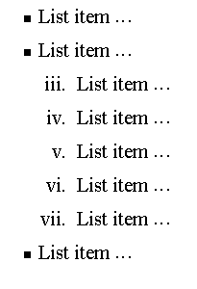
Nesting Lists
You can nest lists by inserting a UL, OL, etc., inside a list item (LI).
EXample
<UL TYPE = “square”>
<LI> List item …</LI>
<LI> List item …
<OL TYPE=“i” START=“3”>
<LI> List item …</LI>
<LI> List item …</LI>
<LI> List item …</LI>
<LI> List item …</LI>
<LI> List item …</LI>
</OL>
</LI>
<LI> List item …</LI>
</UL>

Slide 32
What will be the output?
<H1 ALIGN="CENTER">SAFETY TIPS FOR CANOEISTS</H1> <OL TYPE=“a” START=“2”> <LI>Be able to swim </LI> <LI>Wear a life jacket at all times </LI> <LI>Don't stand up or move around. If canoe tips,
<UL> <LI>Hang on to the canoe </LI> <LI>Use the canoe for support and </LI> <LI>Swim to shore </UL> </LI>
<LI>Don't overexert yourself </LI> <LI>Use a bow light at night </LI> </OL>

Slide 33
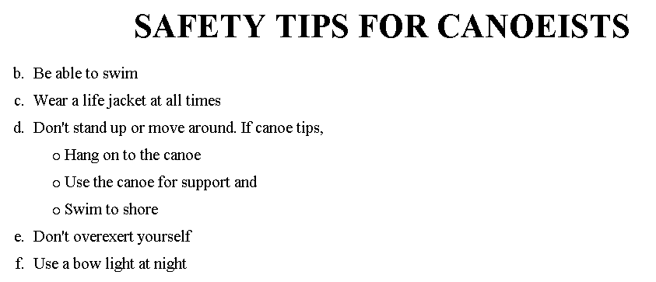
The output….

Slide 34
<H1 ALIGN="CENTER">SAFETY TIPS FOR CANOEISTS</H1>
<OL TYPE="a" START="2">
<LI>Be able to swim </LI>
<LI>Wear a life jacket at all times </LI>
<LI>Don't stand up or move around. If canoe tips,
<UL>
<LI>Hang on to the canoe </LI>
<LI>Use the canoe for support
<OL type="I" start="4">
<LI> Be careful </LI>
<LI> Do not look around</LI>
</LI> </OL>
<LI>Swim to shore
</UL> </LI>
<LI>Don't overexert yourself </LI>
<LI>Use a bow light at night </LI>
</OL>
What
will
be the
output?

Slide 35
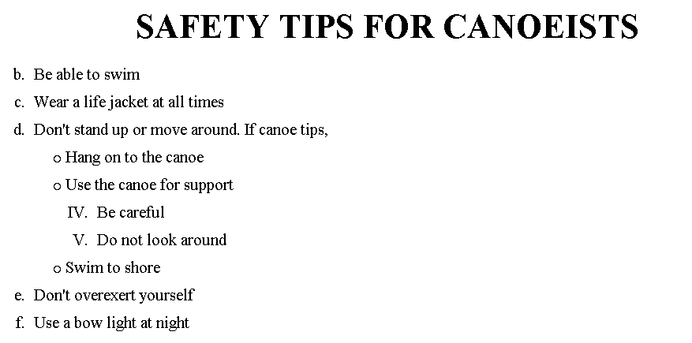
The output….

Slide 36
Topic 2
Images
HREF
FrameSet
Form Control Tags
Audio and Video

Slide 37
Images
<IMG>This element defines a graphic image on the page.
Image File (SRC:source): This value will be a URL (location of the image) E.g. http://www.domain.com/dir/file.ext or /dir/file.txt.
Alternate Text (ALT): This is a text field that describes an image or acts as a label. It is displayed when they position the cursor over a graphic image.
Alignment (ALIGN): This allows you to align the image on your page.

Slide 38
Images
Width (WIDTH): is the width of the image in pixels.
Height (HEIGHT): is the height of the image in pixels.
Border (BORDER): is for a border around the image, specified in pixels.
HSPACE: is for Horizontal Space on both sides of the image specified in pixels. A setting of 5 will put 5 pixels of invisible space on both sides of the image.
VSPACE: is for Vertical Space on top and bottom of the image specified in pixels. A setting of 5 will put 5 pixels of invisible space above and bellow the image.

Slide 39
Some Examples on images
1) <IMG SRC=“jordan.gif“ border=4>
2) <IMG SRC=" jordan.gif" width="60" height="60">
3) <IMG SRC=“jordan.gif" ALT="This is a text that goes with the image">
4) <IMG SRC=" jordan.gif “ Hspace="30" Vspace="10" border=20>
5) < IMG SRC =" jordan.gif“ align="left">
blast blast blast blast blast

Slide 40
HOW TO MAKE A LINK
1) The tags used to produce links are the <A>
and </A>. The <A> tells where the link should start and
the </A> indicates where the link ends.
2) The example below shows how to make the word
Here work as a link to yahoo.
Click <A HREF="http://www.yahoo.com">here</A> to
go to yahoo.
Image as Link :
<a href="default.asp“><img src="smiley.gif" alt="HTML tutorial" style="width:42px;height:42px;border:0“></a>

Slide 41
Image Maps
Image maps are images, usually in gif format that have been divided into regions;
Clicking in a region of the image cause the web surfer to be connected to a new URL.
Image maps are graphical form of creating links between pages.
There are two type of image maps:
Client side and server side
Both types of image maps involve a listing of co-ordinates
that define the mapping regions and which URLs those coordinates are associated with. This is known as the map file.

Slide 42
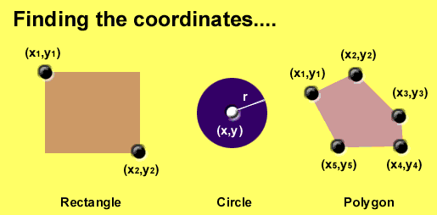
Area Shapes Used

Slide 43
Client-Side Image Maps
Client-side image maps (USEMAP) use a map file that is part of the HTML document (in an element called MAP), and is linked to the image by the Web browser.
<IMG SRC="note.GIF" Width=200 Height=200
border="5" USEMAP="#map1">
<MAP NAME="map1">
<AREA SHAPE="RECT" COORDS="0,0,90,90"
HREF="hi.html" ALT="see me…">
<AREA SHAPE="RECT" COORDS="100,100,160,160"
HREF="divPara.html" ALT="see him…" >
<AREA SHAPE="CIRCLE" COORDS="150,50,20"
HREF="house.html" ALT="see it…" >
</MAP>
We can use Poly as well as Rect……

Slide 44
Shapes, Coords
Types of Shapes
Rect → used for squares and ordered shapes.
Circle → used for circles.
Poly → used for unordered shapes.
Number of coordenations for each shape:
Rect →4 numbers for two corners
Circle →3 numbers for the center & R
Poly → depends on the number of corners of the shape( 2 numbers for each corner)

Slide 45
Tables
In this chapter you will learn that tables have many uses in
HTML.
Objectives:
Upon completing this section, you should be able to:
Insert a table.
Explain a table’s attributes.
Edit a table.
Add a table header.

Slide 46
Tables
The <TABLE></TABLE> element has four sub-elements:
Table Row<TR></TR>.
Table Header <TH></TH>.
Table Data <TD></TD>.
Caption <CAPTION></CAPTION>.
The table row elements usually contain table header elements or table data elements.

Slide 47
Tables
<table border=“1”>
<tr>
<th> Column 1 header </th>
<th> Column 2 header </th>
</tr>
<tr>
<td> Row1, Col1 </td>
<td> Row1, Col2 </td>
</tr>
<tr>
<td> Row2, Col1 </td>
<td> Row2, Col2 </td>
</tr>
</table>

Slide 48
Tables
Column 1 Header | Column 2 Header
Row1, Col1 | Row1, Col2
Row2, Col1 | Row2, Col2

Slide 49
Tables Attributes
BGColor: Some browsers support background colors in a table.
Width: you can specify the table width as an absolute number of pixels or a percentage of the document width. You can set the width for the table cells as well.
Border: You can choose a numerical value for the border width, which specifies the border in pixels.
CellSpacing: Cell Spacing represents the space between cells and is specified in pixels.

Slide 50
Table Attributes
CellPadding: Cell Padding is the space between the cell border and the cell contents and is specified in pixels.
Align: tables can have left, right, or center alignment.
Background: Background Image, will be titled in IE3.0 and above.
BorderColor, BorderColorDark.

Slide 51
Table Caption
A table caption allows you to specify a line of text that will appear centered above or bellow the table.
<TABLE BORDER=1 CELLPADDING=2>
<CAPTION ALIGN=“BOTTOM”> Label For My Table </CAPTION>
The Caption element has one attribute ALIGN that can be either TOP (Above the table) or BOTTOM (below the table).

Slide 52
Table Header
Table Data cells are represented by the TD element. Cells can also be TH (Table Header) elements which results in the contents of the table header cells appearing centered and in bold text.

Slide 53
Table Data and Table Header Attributes
Colspan: Specifies how many cell columns of the table this cell should span.
Rowspan: Specifies how many cell rows of the table this cell should span.
Align: cell data can have left, right, or center alignment.
Valign: cell data can have top, middle, or bottom alignment.
Width: you can specify the width as an absolute number of pixels or a percentage of the document width.
Height: You can specify the height as an absolute number of pixels or a percentage of the document height.

Slide 54
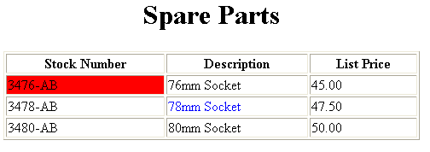
Basic Table Code
<TABLE BORDER=1 width=50%>
<CAPTION> <h1>Spare Parts <h1> </Caption>
<TR><TH>Stock Number</TH><TH>Description</TH><TH>List Price</TH></TR>
<TR><TD bgcolor=red>3476-AB</TD><TD>76mm Socket</TD><TD>45.00</TD></TR>
<TR><TD >3478-AB</TD><TD><font color=blue>78mm Socket</font> </TD><TD>47.50</TD></TR>
<TR><TD>3480-AB</TD><TD>80mm Socket</TD><TD>50.00</TD></TR>
</TABLE>

Slide 55
Table Data and Table Header Attributes
<Table border=1 cellpadding =2>
<tr> <th> Column 1 Header</th> <th> Column 2 Header</th> </tr>
<tr> <td colspan=2> Row 1 Col 1</td> </tr>
<tr> <td rowspan=2>Row 2 Col 1</td>
<td> Row 2 Col2</td> </tr>
<tr> <td> Row 3 Col2</td> </tr>
</table>

Slide 56
Table Data and Table Header Attributes
Column 1 Header | Column 2 Header
Row 1 Col 1
Row 2 Col 1 | Row 2 Col 2
 | Row 3 Col 2

Slide 57
What will be the output?
<TABLE BORDER width=“750”>
<TR> <TD colspan=“4” align=“center”>Page Banner</TD></TR>
<TR> <TD rowspan=“2” width=“25%”>Nav Links</TD><TD colspan=“2”>Feature Article</TD> <TD rowspan=“2” width=“25%”>Linked Ads</TD></TR>
<TR><TD width=“25%”>News Column 1 </TD> <TD width=“25%”><News Column 2 </TD></TR>
</TABLE>

Slide 58
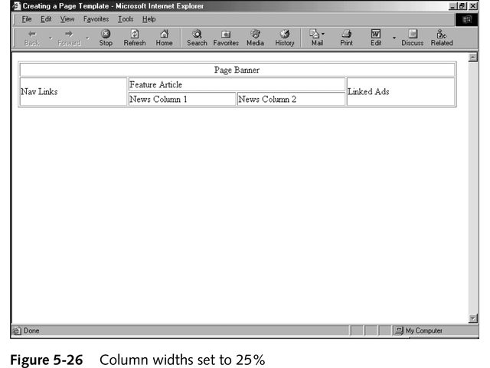
The Output

Slide 59
Frames
Frames are a relatively new addition to the HTML standard.
First introduced in Netscape Navigator 2.0.
Objectives:
Create a Frame based page.
Work with the Frameset, Frame, and Noframes elements.
Use the attributes of the Frames elements to control the display.
Set Targets appropriately.

Slide 60
Frames
A framed page is actually made up of multiple HTML pages.
There is one HTML document that describes how to break up the single browser window into multiple windowpanes.
Each windowpane is filled with an HTML document.
For Example to make a framed page with a windowpane on the left and one on the right requires three HTML pages.
Doc1.html and Doc2.html are the pages that contain content.
Frames.html is the page that describes the division of the single browser window into two windowpanes.

Slide 61
Frames
Doc1.html
Doc2.html
Doc1.html
Doc2.html
Frames.html

Slide 62
Frame Page Architecture
A <FRAMESET> element is placed in the html document before the <BODY> element. The <FRAMESET> describes the amount of screen real estate given to each windowpane by dividing the screen into ROWS or COLS.
The <FRAMESET> will then contain <FRAME> elements, one per division of the browser window.
Note: Because there is no BODY container, FRAMESET pages can't have background images and background colors associated with them.

Slide 63
Frame Page Architecture
<HTML>
<HEAD>
<TITLE> Framed Page </TITLE>
<FRAMeSET COLS=“23%,77%”>
<FRAME SRC=“Doc1.html”>
<FRAME SRC=“Doc2.html”>
</FRAMeSET >
</HEAD>
</HTML>

Slide 64
The Diagram below is a graphical view of the document described above
FRAMESET COLS=”23%, 77%”
FRAME
NAME= left_pane
SRC=Doc1.html
FRAME
NAME=right_pane
SRC= Doc2.html

Slide 65
<FRAMESET> Container
<FRAMESET> : The FRAMESET element creates divisions in the browser window in a single direction. This allows you to define divisions as either rows or columns.
ROWS : Determines the size and number of rectangular rows within a <FRAMESET>. They are set from top of the display area to the bottom.
Possible values are:
Absolute pixel units, I.e. “360,120”.
A percentage of screen height, e.g. “75%,25%”.
Proportional values using the asterisk (*). This is often combined with a value in pixels , e.g. “360,*”.
<Frameset cols=“200,20%,*,2*”>

Slide 66
Creating a Frames Page
COLS: Determines the size and number of rectangular columns within a <FRAMESET>. They are set from left to right of the display area.
Possible values are:
Absolute pixel units, I.e. “480,160”.
A percentage of screen width, e.g. “75%,25%”.
Proportional values using the asterisk (*). This is often combined with a value in pixels , e.g. “480,*”.

Slide 67
Creating a Frames Page
FRAMEBORDER : Possible values 0, 1, YES, NO. A setting of zero will create a borderless frame.
FRAMESPACING: This attribute is specified in pixels. If you go to borderless frames you will need to set this value to zero as well, or you will have a gap between your frames where the border used to be.
BORDER(thickness of the Frame): This attribute specified in pixels. A setting of zero will create a borderless frame. Default value is 5.
BORDERCOLOR: This attribute is allows you choose a color for your border. This attribute is rarely used.

Slide 68
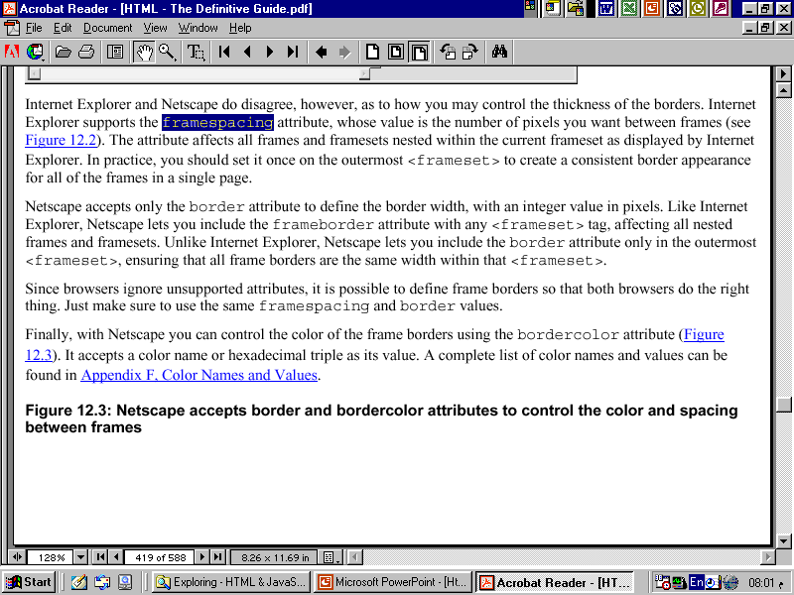

Slide 69
<FRAME>
<FRAME>: This element defines a single frame within a frameset. There will be a FRAME element for each division created by the FRAMESET element. This tag has the following attributes:
SRC: Required, as it provides the URL for the page that will be displayed in the frame.
NAME: Required for frames that will allow targeting by other HTML documents. Works in conjunction with the target attribute of the <A>, <AREA>, <BASE>, and <FORM> tags.

Slide 70
<FRAME>
MARGINWIDTH: Optional attribute stated in pixels. Determines horizontal space between the <FRAME> contents and the frame’s borders.
MARGINHEIGHT: Optional attribute stated in pixels. Determines vertical space between the <FRAME> contents and the frame’s borders.
SCROLLING: Displays a scroll bar(s) in the frame. Possible values are:
Yes – always display scroll bar(s).
No – never display scroll bar(s).
Auto – browser will decide based on frame contents.
By default: scrolling is auto.

Slide 71
<FRAME>
NORESIZE: Optional – prevents viewers from resizing the frame. By default the user can stretch or shrink the frame’s display by selecting the frame’s border and moving it up, down, left, or right.

Slide 72
<NOFRAMES>
<NOFRAMES>: Frame – capable browsers ignore all HTML within this tag including the contents of the BODY element. This element does not have any attributes.
<HTML>
<HEAD>
<TITLE> Framed Page </TITLE>
</HEAD>

Slide 73
<NOFRAMES>
<FRAMESET COLS="23%,77%">
<FRAME SRC="" NAME="left_pane“>
<FRAME SRC="" NAME="right_pane">
<NOFRAMES>
<P> This is a Framed Page. Upgrade your browser to support frames.</P>
</NOFRAMES></FRAMESET>

Slide 74
Compound FRAMESET Divisions
In this case a second FRAMESET element will be inserted in the place of the FRAME element that would describe the second row.
The second FRAMESET element will divide the remaining screen real estate into 2 columns.
This nested FRAMESET will then be followed by 2 FRAME elements to describe each of the subsequent frame divisions created.

Slide 75
Compound FRAMESET Divisions
<html>
<head>
<title> Compound Frames Page</title>
</head>
<frameset rows=“120,*”>
<frame src=“banner_file.html” name”banner”>
<frameset cols=“120,*”>
<frame src=“links_file.html” name=“links”>
<frame src=“content_file.html” name=“content”>
<noframes>
<p>
Default message
</p>
</noframes>
</frameset>
</frameset>
</head>

Slide 76
Compound FRAMESET Divisions You may want to create a frames design with a combination of rows and columns.
Banner File
Links
File
Contents File

Slide 77
Compound FRAMESET Divisions Example
<HEAD>
<FRAMESET ROWS="25%,50%,25%”
<FRAME SRC="">
<FRAMESET COLS="25%,*">
<FRAME SRC="">
<FRAME SRC="">
</FRAMESET>
<FRAME SRC="">
</FRAMESET>
</HEAD>

Slide 78
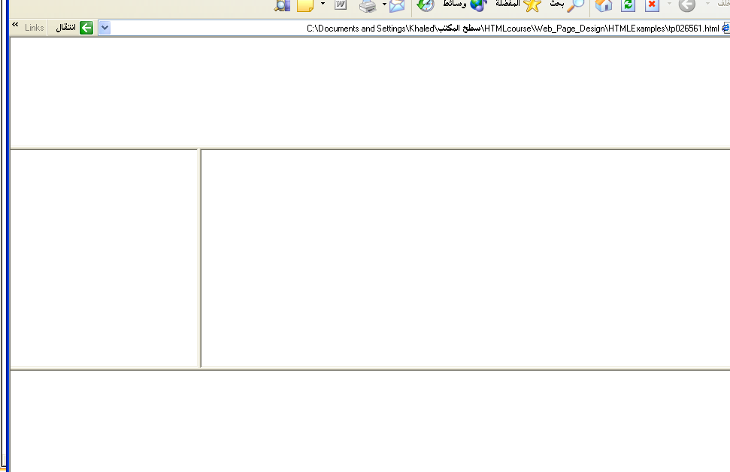
Output

Slide 79
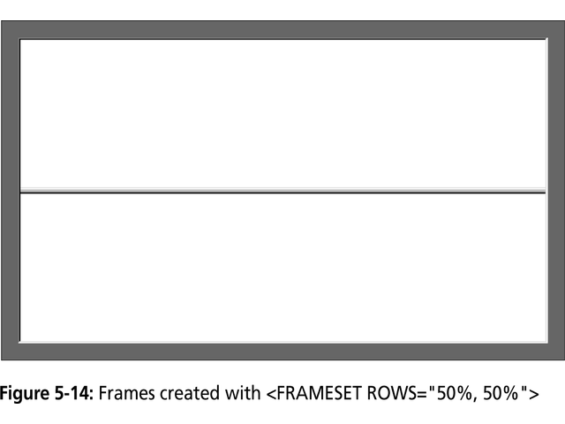

Slide 80
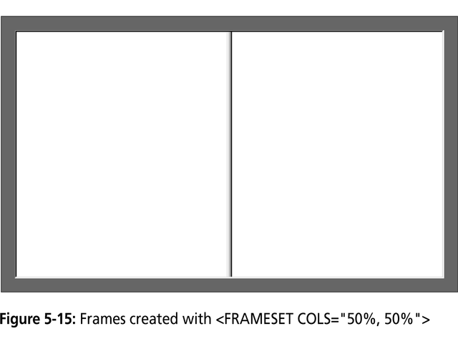

Slide 81
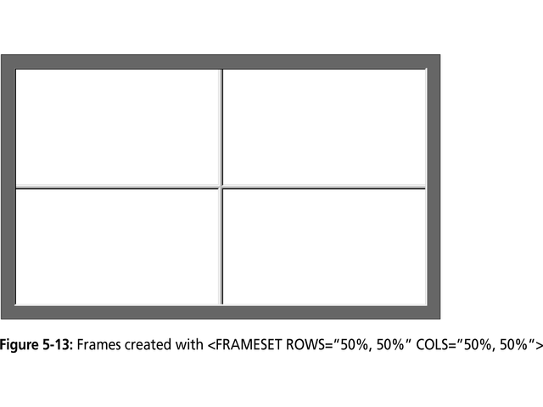

Slide 82
Frame Formatting
Example:
<frameset rows=“20%, *, 20%”>
<frame src=“header.html” noresize scrolling=no>
<frame src=“body.html”>
<frame src=“navigationbar.html” noresize scrolling=no>
</frameset>

Slide 83
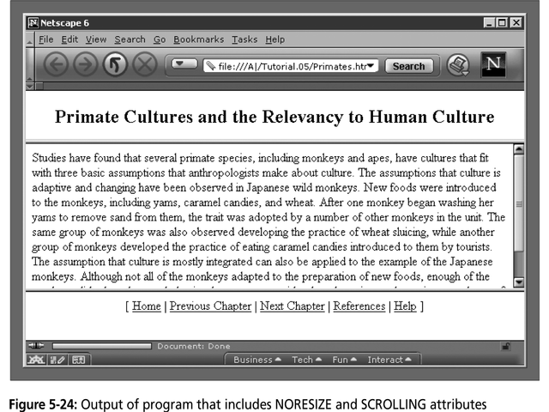

Slide 84
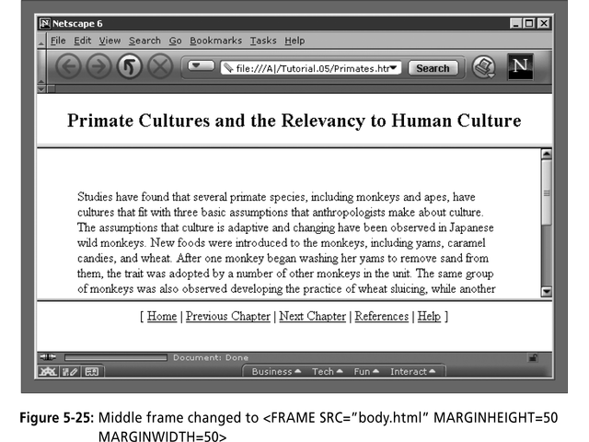

Slide 85
What do the following mean?
<FRAMESET COLS="2*, 3*, 5*">
2) <FRAMESET COLS="150, 20%, *, 3*">
So what are the space-allocation priorities? Absolute pixel values are always assigned space first, in order from left to right. These are followed by percentage values of the total space. Finally, proportional values are divided based upon what space is left.

Slide 86
Generic Frame Formula
The <FRAME> tag has six associated attributes: SRC, NAME, MARGINWIDTH, MARGINHEIGHT, SCROLLING, and NORESIZE. Here's a complete generic FRAME:
<FRAME SRC="url" NAME="window_name" SCROLLING=YES|NO|AUTO MARGINWIDTH="value" MARGINHEIGHT="value"
NORESIZE>

Slide 87
What will be the Output?
<FRAMESET ROWS="*, 2*, *" COLS="2*, *">
<FRAME SRC=“”>
<FRAME SRC=“”>
<FRAME SRC=“”>
<FRAME SRC=“”>
<FRAME SRC=“”>
<FRAME SRC=“”>
</FRAMESET>

Slide 88
Targets
When you use links for use in a frames environment you will need to specify an additional attribute called TARGET.
The TARGET attribute uses the NAME attribute of the FRAME element.
If we were to place a link in doc1.html that linked to doc3.html and we wanted doc3.html to be displayed in the right windowpane; the HTML code would appear in doc1.html as follows:
<A HREF=“doc3.html” TARGET=“right_pane”>Link to Document 3 </A>

Slide 89
Special Targets
There are 4 special target names that cannot be assigned by the NAME attribute of the FRAME tag.
1. TARGET=“_top” : This loads the linked document into the full browser window with the URL specified by the HREF attribute. All frames disappear, leaving the new linked page to occupy the entire window. The back is turned on.
2. TARGET=“_blank” : Opens an unnamed new browser window and loads the document specified in the URL attribute into the new window (and your old window stays open). The back is turned off. Other windows remains on.
3. TARGET=“_self” : Loads the document in the same window where the anchor was {Clicked}. This is the default setting for linking elements.
4. TARGET=“_parent” : the _parent frame is a prior frameset that the current frameset was “spawned” from. If there isn’t one it is the browser window. The document is loaded into the area occupied by the columns or rows frameset containing the frame that contains the link. The back is turned on. All windows disappear.

Slide 90
If a frame contains the following link, then clicking the link launches a new, unnamed browser display window that contains the content defined in stuff.HTM. This can be a simple HTML document, or an entirely new FRAMESET definition.
1. <A HREF="stuff.html" TARGET="_blank">
If a frame contains the following link, then clicking the link will simply cause the frame which contains the link to clear, and its content will be replaced with whatever is in stuff.htm.
2. <A HREF="stuff.html" TARGET="_self">
If a frame contains the following link, the frameset that contains the frame that contains this link will be replaced by stuff.HTM.
3. <A HREF="stuff.html" TARGET="_parent">
Finally, if a frame contains the following link, clicking the link replaces the entire browser window with the contents of stuff.HTM.
4. <A HREF="stuff.html" TARGET="_top">

Slide 91
Targeting links to frames
The TARGET attribute allows you to specify the frame into which a page is to be loaded into in a frames setting.
<A HREF=“chap1.html” TARGET=“_self”> [Chapter 1]</A>
<A HREF=“chap1.html” TARGET=“_parent”> [Chapter 2]</A>
Parent window
chap1.html
Learning HTML
[Chapter 1][Chapter 2][Chapter 3]
chap2.html

Slide 92
Targeting links to frames
The TARGET attribute allows you to specify the frame into which a page is to be loaded into in a frames setting.
<A HREF=“chap1.html” TARGET=“bottom”> [Chapter 1]</A>
<A HREF=“chap2.html” TARGET=“bottom”> [Chapter 2]</A>
<A HREF=“chap3.html” TARGET=“bottom”> [Chapter 3]</A>
chap1.html
Learning HTML
[Chapter 1][Chapter 2][Chapter 3]
chap2.html
chap3.html

Slide 93
Forms
Forms add the ability to web pages to not only provide the person viewing the document with dynamic information but also to obtain information from the person viewing it, and process the information.
Objectives:
Upon completing this section, you should be able to
Create a FORM.
Add elements to a FORM.
Define CGI (Common Gateway Interface).
Describe the purpose of a CGI Application.
Specify an action for the FORM.
Forms work in all browsers.
Forms are Platform Independent.

Slide 94
Forms
To insert a form we use the <FORM></FORM> tags. The rest of the form elements must be inserted in between the form tags.
<HTML> <HEAD>
<TITLE> Sample Form</TITLE>
</HEAD>
<BODY BGCOLOR=“FFFFFF”>
<FORM ACTION = http://www.xnu.com/formtest.asp>
<P> First Name: <INPUT TYPE=“TEXT” NAME=“fname” MAXLENGTH=“50”> </P>
<P> <INPUT TYPE=“SUBMIT” NAME=“fsubmit1” VALUE=“Send Info”> </P>
</FORM>
</BODY> </HTML>

Slide 95
<FORM> element attributes
ACTION: is the URL of the CGI (Common Gateway Interface) program that is going to accept the data from the form, process it, and send a response back to the browser.
METHOD: GET (default) or POST specifies which HTTP method will be used to send the form’s contents to the web server. The CGI application should be written to accept the data from either method.
NAME: is a form name used by VBScript or
JavaScripts.
TARGET: is the target frame where the response page will show up.

Slide 96
Form Elements
Form elements have properties: Text boxes, Password boxes, Checkboxes, Option(Radio) buttons, Submit, Reset, File, Hidden and Image.
The properties are specified in the TYPE Attribute of the HTML element <INPUT></INPUT>.

Slide 97
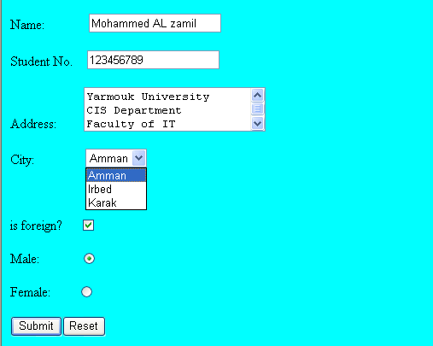
Sami Ali
Al al-Bayt University

Slide 98
Form Elements
<INPUT> Element’s Properties
TYPE= Type of INPUT entry field.
NAME = Variable name passed to CGI application
VALUE= The data associated with the variable name to be passed to the CGI application
CHECKED= Button/box checked
SIZE= Number of visible characters in text field
MAXLENGHT= Maximum number of characters accepted.

Slide 99

Text Box
Text boxes: Used to provide input fields for text, phone numbers, dates, etc.
<INPUT TYPE= " TEXT " >
Browser will display
Textboxes use the following attributes:
TYPE: text.
SIZE: determines the size of the textbox in characters. Default=20 characters.
MAXLENGHT : determines the maximum number of characters that the field will accept.
NAME: is the name of the variable to be sent to the CGI application.
VALUE: will display its contents as the default value.

Slide 100
Example on Text Box
<TITLE>Form_Text_Type</TITLE>
</HEAD> <BODY>
<h1> <font color=blue>Please enter the following bioData</font></h1>
<FORM name="fome1" Method= " get " Action= " URL " >
First Name: <INPUT TYPE="TEXT" NAME="FName"
SIZE="15" MAXLENGTH="25"><BR>
Last Name: <INPUT TYPE="TEXT" NAME="LName"
SIZE="15" MAXLENGTH="25"><BR>
Nationality: <INPUT TYPE="TEXT" NAME="Country"
SIZE="25" MAXLENGTH="25"><BR>
The Phone Number: <INPUT TYPE="TEXT" NAME="Phone"
SIZE="15" MAXLENGTH="12"><BR>
</FORM> </BODY> </HTML>

Slide 101
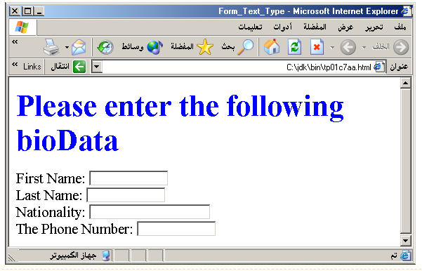
Output

Slide 102
Password
Password: Used to allow entry of passwords.
<INPUT TYPE= " PASSWORD " >
Browser will display
Text typed in a password box is starred out in the browser
display.
Password boxes use the following attributes:
TYPE: password.
SIZE: determines the size of the textbox in characters.
MAXLENGHT: determines the maximum size of the password in characters.
NAME: is the name of the variable to be sent to the CGI application.
VALUE: is usually blank.

Slide 103
Example on Password Box
<HTML><HEAD>
<TITLE>Form_Password_Type</TITLE></HEAD>
<BODY>
<h1> <font color=red>To Access, Please
enter:</font></h1>
<FORM name="fome2" Action="url" method="get">
User Name: <INPUT TYPE="TEXT" Name="FName"
SIZE="15" MAXLENGTH="25"><BR>
Password: <INPUT TYPE="PASSWORD"
NAME="PWord" value="" SIZE="15”
MAXLENGTH="25"><BR>
</FORM></BODY> </HTML>

Slide 104
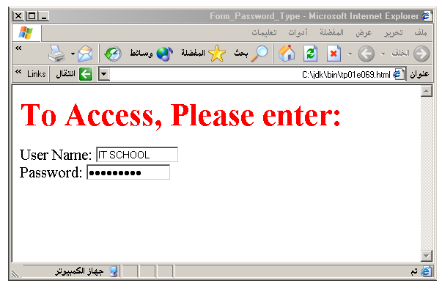
Output

Slide 105
Hidden
Hidden: Used to send data to the CGI application that you don’t want the web surfer to see, change or have to enter but is necessary for the application to process the form correctly.
<INPUT TYPE=“HIDDEN”>
Nothing is displayed in the browser.
Hidden inputs have the following attributes:
TYPE: hidden.
NAME: is the name of the variable to be sent to the CGI application.
VALUE: is usually set a value expected by the CGI application.

Slide 106
Check Box
Check Box: Check boxes allow the users to select more than one option.
<INPUT TYPE=“CHECKBOX”>
Browser will display
Checkboxes have the following attributes:
TYPE: checkbox.
CHECKED: is blank or CHECKED as the initial
status.
NAME: is the name of the variable to be sent to the
CGI application.
VALUE: is usually set to a value.

Slide 107
<HTML> <HEAD><TITLE>CheckBoxType</TITLE> </HEAD>
<BODY>
<h1> <font color=green>Please check one of the following</font></h1>
<FORM name="fome3" Action="url" method="get">
<font color=red> Select Country: </font><BR>
jordan:<INPUT TYPE="CheckBox" Name="country" CHECKED><BR>
Yemen<INPUT TYPE="CheckBox" Name="country"><BR>
Qatar:<INPUT TYPE="CheckBox" Name="country"><BR> <BR>
<font color=blue>Select Language:</font><BR>
Arabic:<INPUT TYPE="CheckBox" Name="language" CHECKED><BR> English:<INPUT TYPE="CheckBox" Name="language"><BR>
French:<INPUT TYPE="CheckBox" Name="language"> <BR></FORM> </BODY></HTML>

Slide 108
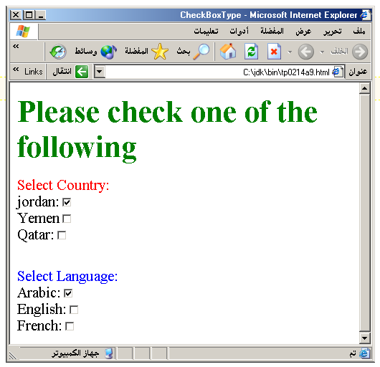
Output

Slide 109
Radio Button
Radio Button: Radio buttons allow the users to select
only one option.
<INPUT TYPE=“RADIO”>
Browser will display
Radio buttons have the following attributes:
TYPE: radio.
CHECKED: is blank or CHECKED as the initial
status. Only one radio button can be
checked
NAME: is the name of the variable to be sent to the
CGI application.
VALUE: usually has a set value.

Slide 110
<HTML> <HEAD><TITLE>CheckBoxType</TITLE> </HEAD>
<BODY>
<h1> <font color=green>Please check one of the following</font></h1>
<FORM name="fome3" Action="url" method="get">
<font color=red> Select Country: </font><BR>
jordan:<INPUT TYPE= "RADIO" Name="country" CHECKED><BR>
Yemen<INPUT TYPE="RADIO " Name="country"><BR>
Qatar:<INPUT TYPE="RADIO" Name="country"><BR> <BR>
<font color=blue>Select Language:</font><BR>
Arabic:<INPUT TYPE="RADIO" Name="language" CHECKED><BR> English:<INPUT TYPE=" RADIO " Name="language"><BR>
French:<INPUT TYPE=" RADIO " Name="language"> <BR></FORM> </BODY></HTML>

Slide 111
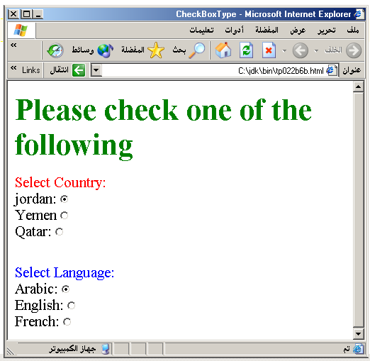

Slide 112
<HTML><HEAD>
<TITLE>RADIOBox</TITLE> </HEAD>
<BODY>
Form #1:
<FORM>
<INPUT TYPE="radio" NAME="choice" VALUE="one"> Yes.
<INPUT TYPE="radio" NAME="choice" VALUE="two"> No.
</FORM>
<HR color=red size="10" >
Form #2:
<FORM>
<INPUT TYPE="radio" NAME="choice" VALUE="three" CHECKED> Yes.
<INPUT TYPE="radio" NAME="choice" VALUE="four"> No.
</FORM>
</BODY></HTML>

Slide 113
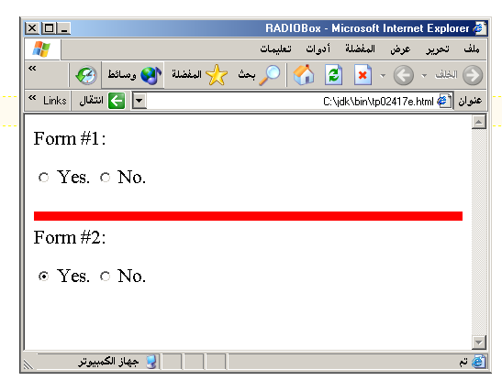
Output

Slide 114
Push Button
Push Button: This element would be used with
JavaScript to cause an action to take place.
<INPUT TYPE=“BUTTON”>
Browser will display
Push Button has the following attributes:
TYPE: button.
NAME: is the name of the button to be used
in scripting.
VALUE: determines the text label on the button.

Slide 115
<DIV align=center><BR><BR>
<FORM>
<FONT Color=red>
<h1>Press Here to see a baby crying:<BR>
<INPUT TYPE="button" VALUE="PressMe"><BR><BR>
<FONT Color=blue>
Click Here to see a baby shouting:<BR>
<INPUT TYPE="button" VALUE="ClickMe" > <BR><BR>
<FONT Color=green>
Hit Here to see a baby eating:<BR>
<INPUT TYPE="button" VALUE="HitME" > <BR><BR>
<FONT Color=yellow>
</FORM></DIV>

Slide 116
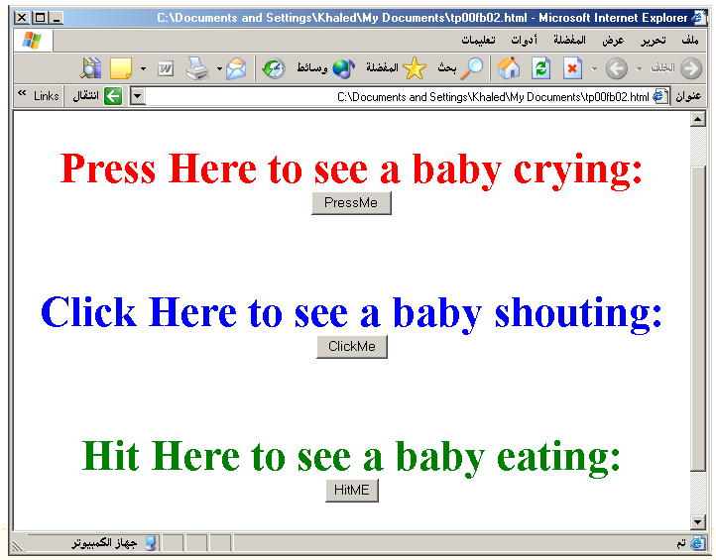

Slide 117
Submit Button
Submit: Every set of Form tags requires a Submit button. This is the element causes the browser to send the names and values of the other elements to the CGI Application specified by the ACTION attribute of the FORM element.
<INPUT TYPE=“SUBMIT”>
The browser will display
Submit has the following attributes:
TYPE: submit.
NAME: value used by the CGI script for processing.
VALUE: determines the text label on the button, usually Submit Query.

Slide 118
<FORM Action="URL" method="get">
First Name: <INPUT TYPE="TEXT" Size=25 name="firstName"><BR>
Family Name: <INPUT TYPE="TEXT" Size=25 name="LastName"><BR>
<BR>
<FONT Color=red>
Press Here to submit the data:<BR>
<INPUT TYPE="submit" VALUE="SubmitData " >
</FORM>

Slide 119
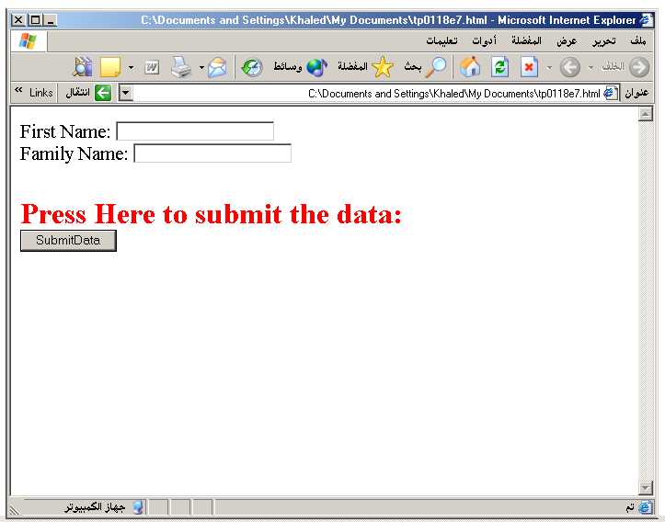

Slide 120
Reset Button
Reset: It is a good idea to include one of these for each form where users are entering data. It allows the surfer to clear all the input in the form.
<INPUT TYPE=“RESET”>
Browser will display
Reset buttons have the following attributes:
TYPE: reset.
VALUE: determines the text label on the button, usually Reset.

Slide 121
<FORM Action="URL" method="get">
First Name: <INPUT TYPE="TEXT" Size=25 name="firstName"> <BR>
Family Name: <INPUT TYPE="TEXT" Size=25 name="LastName"><BR>
<BR>
<FONT Color = red>
<STRONG><font size=5>Press Here to submit the data:</font></STRONG><BR>
<INPUT TYPE="submit" VALUE="SubmitData">
<INPUT TYPE="RESET" VALUE="Reset">
</FORM>

Slide 122
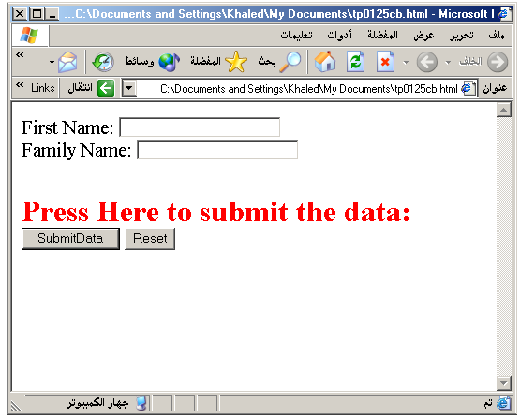

Slide 123
Image Submit Button
Image Submit Button: Allows you to substitute an image for the standard submit button.
<INPUT TYPE=“IMAGE” SRC=“jordan.gif”>
Image submit button has the following attributes:
TYPE: Image.
NAME: is the name of the button to be used in scripting.
SRC: URL of the Image file.

Slide 124
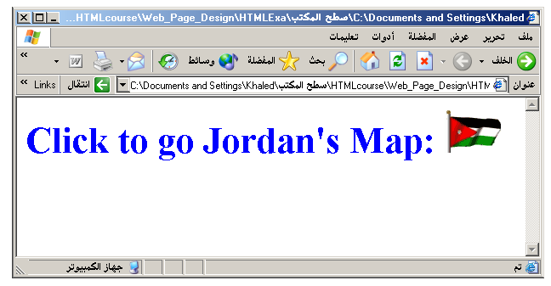
<form> <H1><font color=blue> Click to go Jordan’s Map: <INPUT TYPE="IMAGE" SRC="jordan.gif"> </form>

Slide 125

File
File Upload: You can use a file upload to allow surfers to upload files to your web server.
<INPUT TYPE=“FILE”>
Browser will display
File Upload has the following attributes:
TYPE: file.
SIZE: is the size of the text box in characters.
NAME: is the name of the variable to be sent to the
CGI application.
MAXLENGHT: is the maximum size of the input in the
textbox in characters.

Slide 126
<BODY bgcolor=lightblue>
<form>
<H3><font color=forestgreen>
Please attach your file here to for uploading to
My <font color =red>SERVER...<BR>
<INPUT TYPE="File" name="myFile" size="30">
<INPUT TYPE="Submit" value="SubmitFile">
</form>
</BODY>

Slide 127
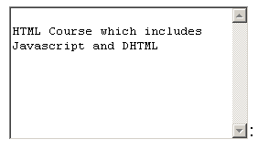
Other Elements used in Forms
<TEXTAREA></TEXTAREA>: is an element that allows for free form text entry.
Browser will display
Textarea has the following attributes:
NAME: is the name of the variable to be sent to the CGI application.
ROWS: the number of rows to the textbox.
COLS: the number of columns to the textbox.

Slide 128
<BODY bgcolor=lightblue>
<form>
<TEXTAREA COLS=40 ROWS=20 Name="comments" >
From observing the apathy of those
about me during flag raising I
concluded that patriotism if not
actually on the decline is at least
in a state of dormancy.
Written by Khaled Al-Fagih
</TEXTAREA>:
</form>
</BODY>

Slide 129
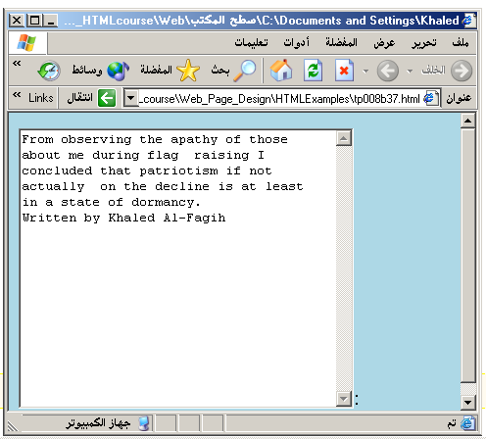

Slide 130
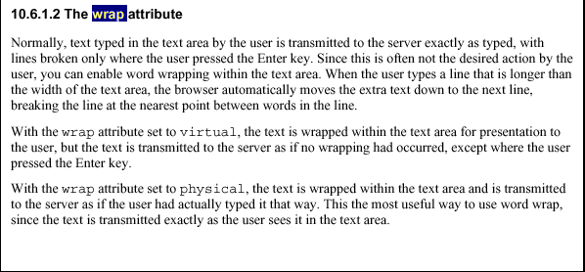

Slide 131
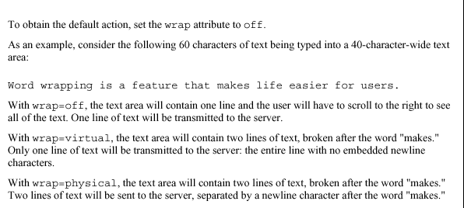

Slide 132
Other Elements used in Forms
The two following examples are <SELECT></SELECT> elements, where the attributes are set differently.
The Select elements attributes are:
NAME: is the name of the variable to be sent to the CGI application.
SIZE: this sets the number of visible choices.
MULTIPLE: the presence of this attribute signifies that the user can make multiple selections. By default only one selection is allowed.

Slide 133
<BODY bgcolor=lightblue>
<form>
Select the cities you have visited:
<SELECT name=“list” size=5>
<option> London</option>
<option> Tokyo</option>
<option> Paris</option>
<option> New York</option>
<option> LA</option>
<option> KL</option>
</SELECT>
</form>
</BODY>

Slide 134
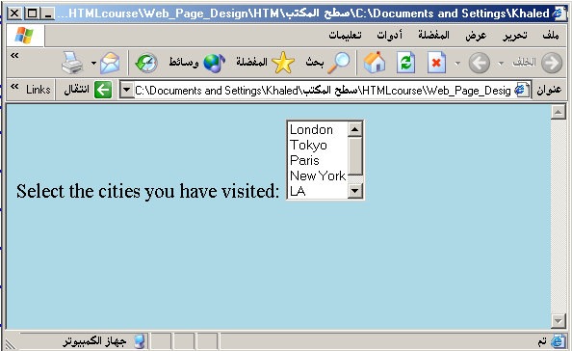

Slide 135
Other Elements used in Forms
Drop Down List:
Name: is the name of the variable to be sent to the CGI application.
Size: 1.

Slide 136

Other Elements used in Forms
List Box:
Name: is the name of the variable to be sent to the CGI application.
SIZE: is greater than one.

Slide 137
Other Elements used in Forms
Option
The list items are added to the <SELECT> element by inserting <OPTION></OPTION> elements.
The Option Element’s attributes are:
SELECTED: When this attribute is present, the option is selected when the document is initially loaded. It is an error for more than one option to be selected.
VALUE: Specifies the value the variable named in the select element.

Slide 138
</HEAD>
<BODY>
<h2><font color=blue>What type of Computer do you have?</font><h2>
<FORM>
<SELECT NAME="ComputerType" size=4>
<OPTION value="IBM" SELECTED> IBM</OPTION>
<OPTION value="INTEL"> INTEL</OPTION>
<OPTION value=" Apple"> Apple</OPTION>
<OPTION value="Compaq"> Compaq</OPTION>
</SELECT>
</FORM></BODY></HTML>

Slide 139
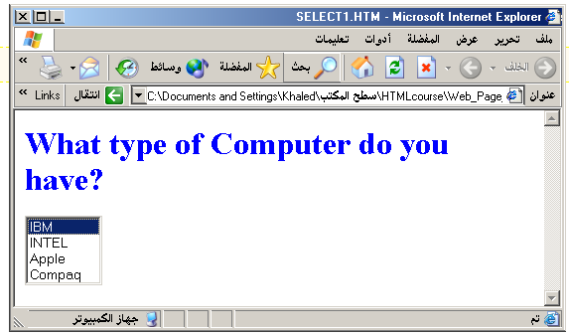

Slide 140
<HEAD> <TITLE>SELECT with Mutiple </TITLE> </HEAD>
<BODY>
<h2><font color=blue>What type of Computer do you have?</font><h2>
<FORM>
<SELECT NAME="ComputerType" size=5 multiple>
<OPTION value="IBM" > IBM</OPTION>
<OPTION value="INTEL"> INTEL</OPTION>
<OPTION value=" Apple"> Apple</OPTION>
<OPTION value="Compaq" SELECTED> Compaq</OPTION>
<OPTION value=" other"> Other</OPTION>
</SELECT>
</FORM></BODY></HTML>

Slide 141
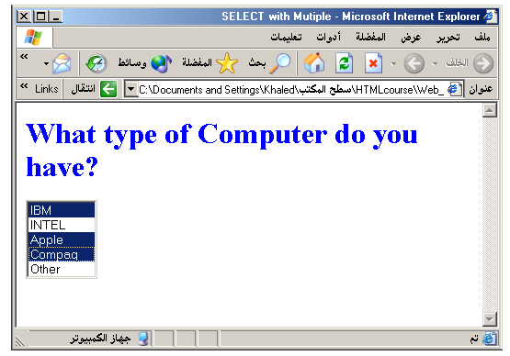

Slide 142
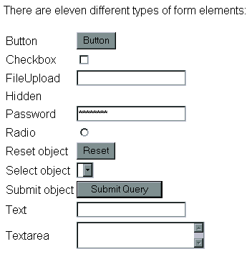

Slide 143
HTML <audio> Element
To play an audio file in HTML, use the <audio> element:
Example
<audio controls> <source src="horse.ogg" type="audio/ogg"> <source src="horse.mp3" type="audio/mpeg"> Your browser does not support the audio element. </audio>

Slide 144
HTML <video> Element
To show a video in HTML, use the <video> element:
Example
<video width="320" height="240" controls> <source src="movie.mp4“ type="video/mp4"> <source src="movie.ogg" type="video/ogg"> Your browser does not support the video tag. </video>

Slide 145
To start a video automatically use the autoplay attribute:
Example
<video width="320" height="240" autoplay> <source src="movie.mp4" type="video/mp4"> <source src="movie.ogg" type="video/ogg"> Your browser does not support the video tag. </video>

